Slide 1
Presented by the Vermont Veterinary Medical Association
Notes:
Hello, my name is Dr Lisa Nelson and I am veterinarian. Thank you for inviting me today and welcome to the SAFE Dog Bite Prevention program. How many of you have dogs in your family?

Slide 2
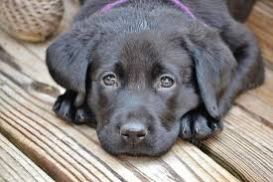
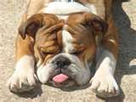
Dogs make wonderful friends… but we have to learn how to be safe around them
Notes:
Please read text:
We all know that….

Slide 3
These kids are having fun but …..
Notes:
Please read text

Slide 4
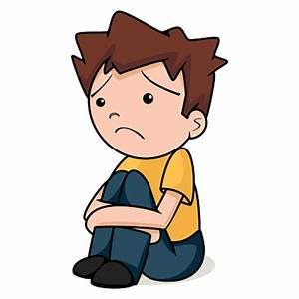
…over 100 Vermont kids go to hospitals every year because of dog bites
Notes:
But did you know that over…..

Slide 5
Our goal
We want you to have fun learning about dogs today
We want to help you learn to be safer around dogs and help dogs feel safer around you
Notes:
Please read text

Slide 6
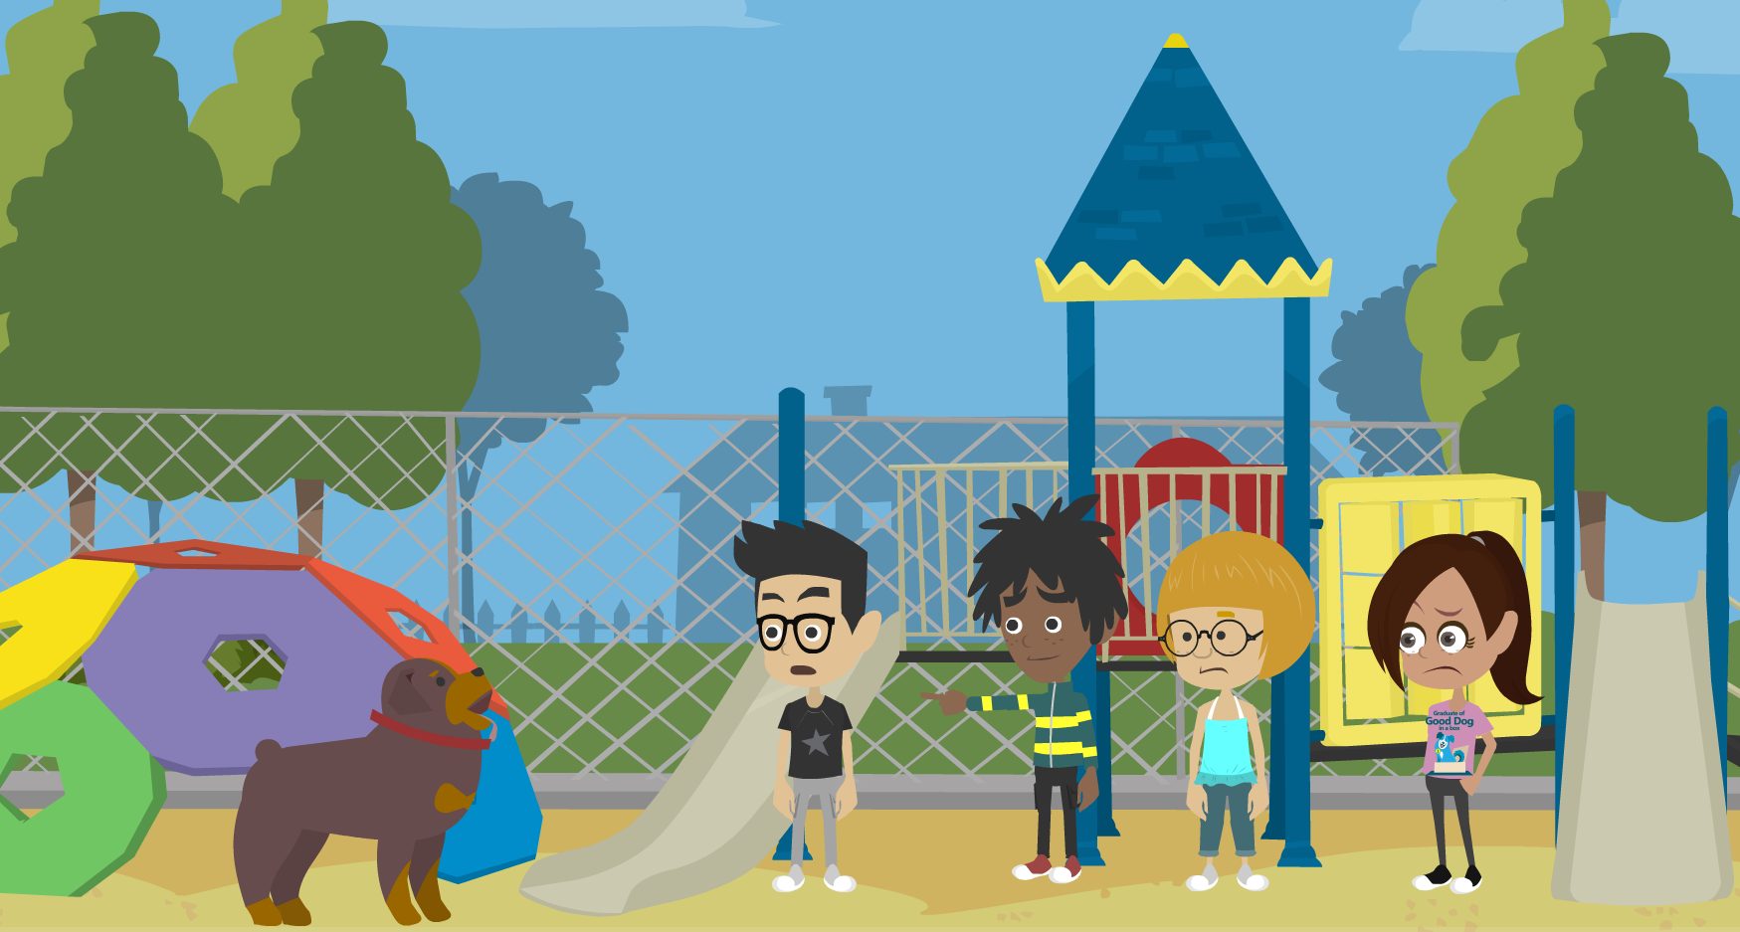
Dogs You Don’t Know
He looks kind of scary!
I am nervous..
Should we run?
Oh no, this dog is loose!
Notes:
Let’s start out with what to do around a dog that you don’t know.
What if you’re approached by a loose dog. Maybe you’re at the park or in your neighborhood or in your own back yard playing. What would you do if the dog was barking or growling at you or chasing you?

Slide 7
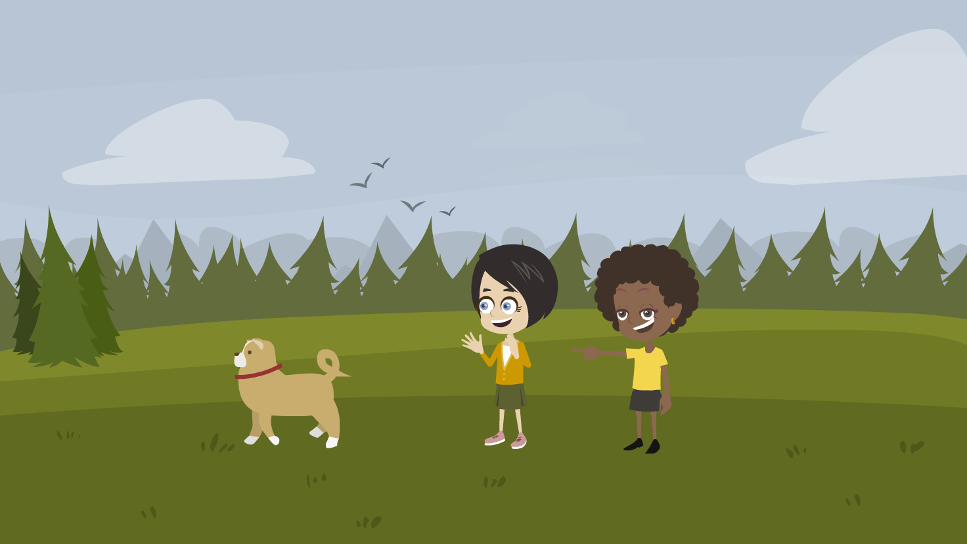
Never approach a loose dog!
Notes:
First of all, never approach a loose dog. No matter how cute the dog is, you should find an adult and tell him or her about the dog.

Slide 8
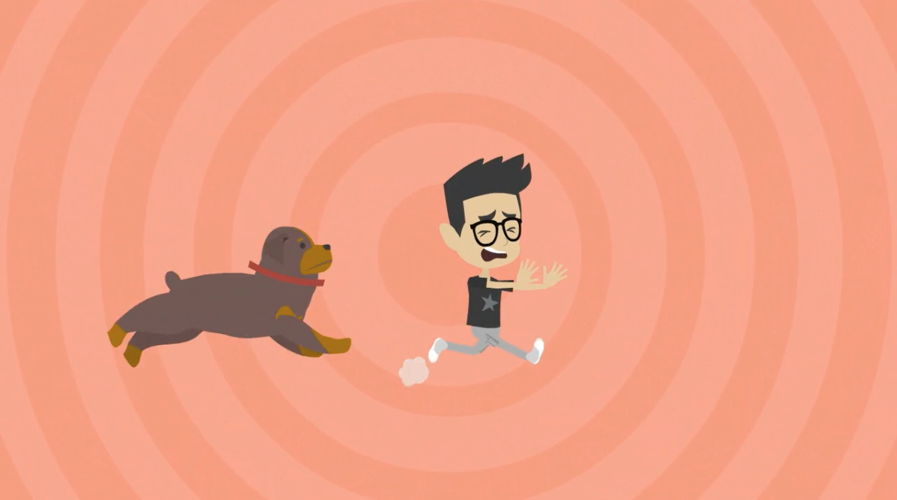
Don’t run and scream!!
Notes:
If a loose dog chases you, you definitely don’t want to run and scream.

Slide 9
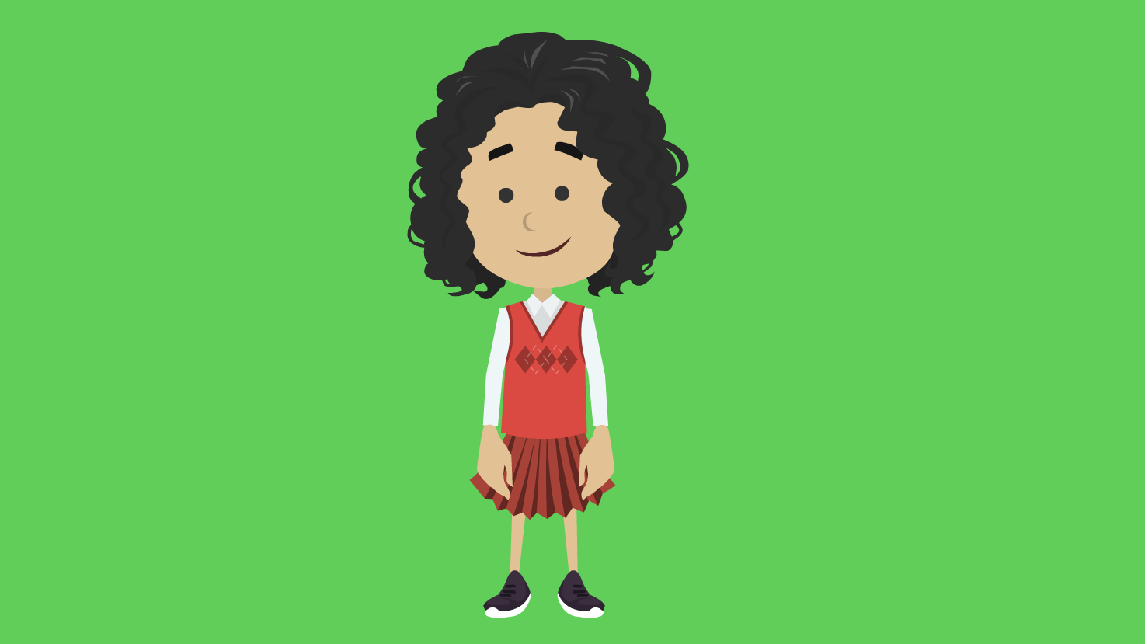
Play the
SAFE
game
Don’t run and scream
Notes:
Instead, you want to be still and quiet. So we have a very simple game you can learn to play called SAFE.

Slide 10
Notes:
Step 1: Stay still and chill - Don’t move and don’t yell, talk or even whisper!

Slide 11
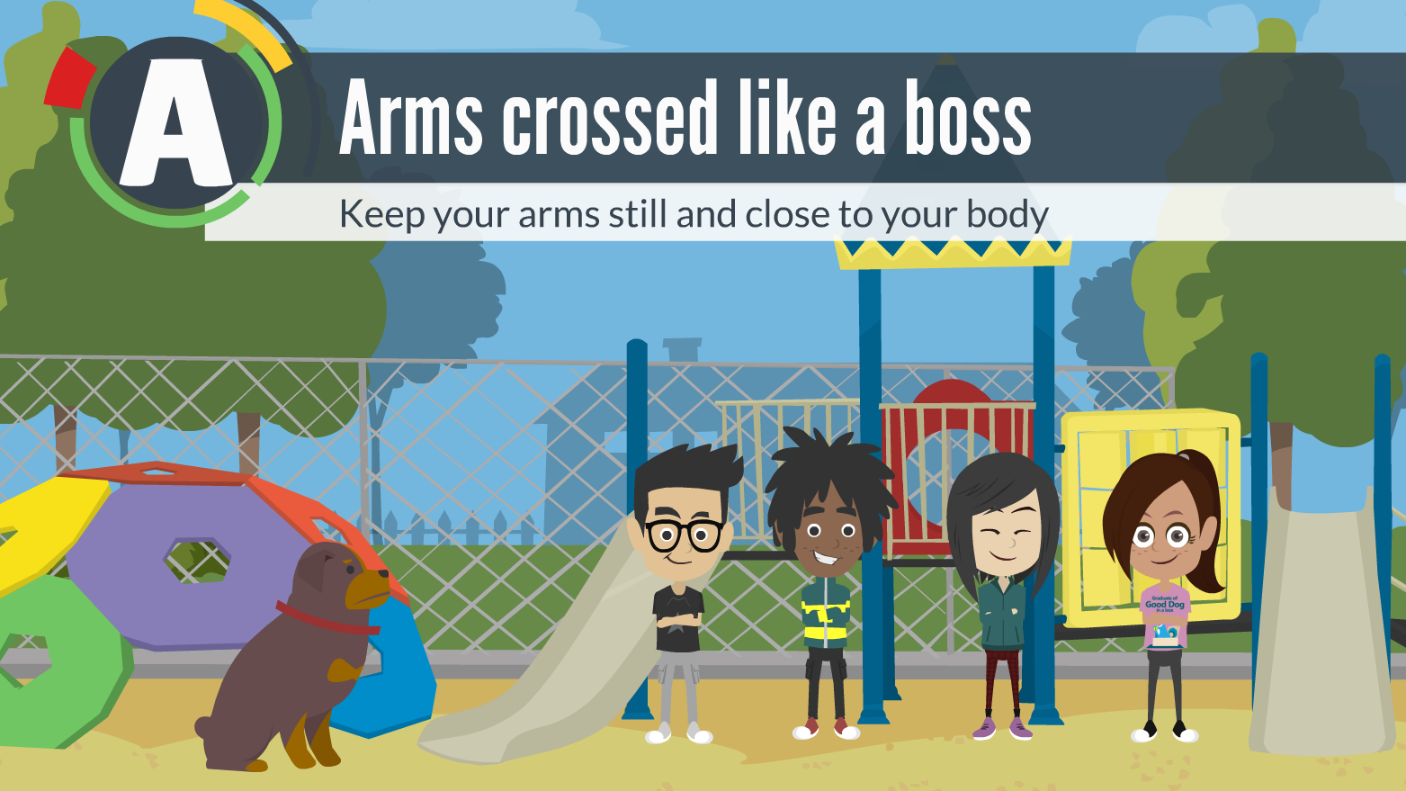
Notes:
Step 2: Arms crossed like a boss - Keep your arms still and close to your body. No wiggling!

Slide 12
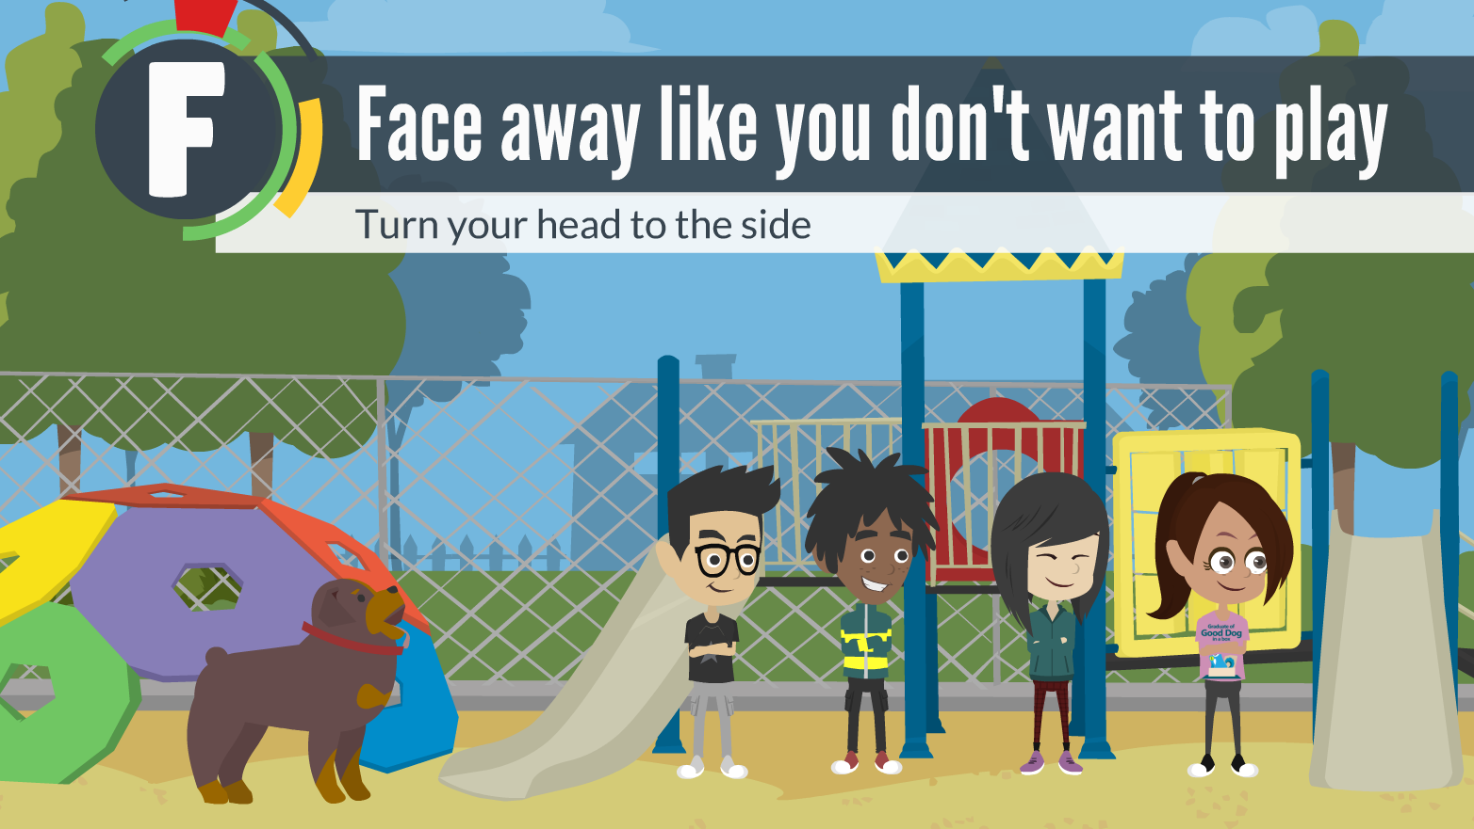
Notes:
Step 3: Face away, like you don’t want to play - Turn your head to the side and away from the dog.

Slide 13
Notes:
Step 4: Look down down at the ground - Don’t look at or stare at the dog.

Slide 14
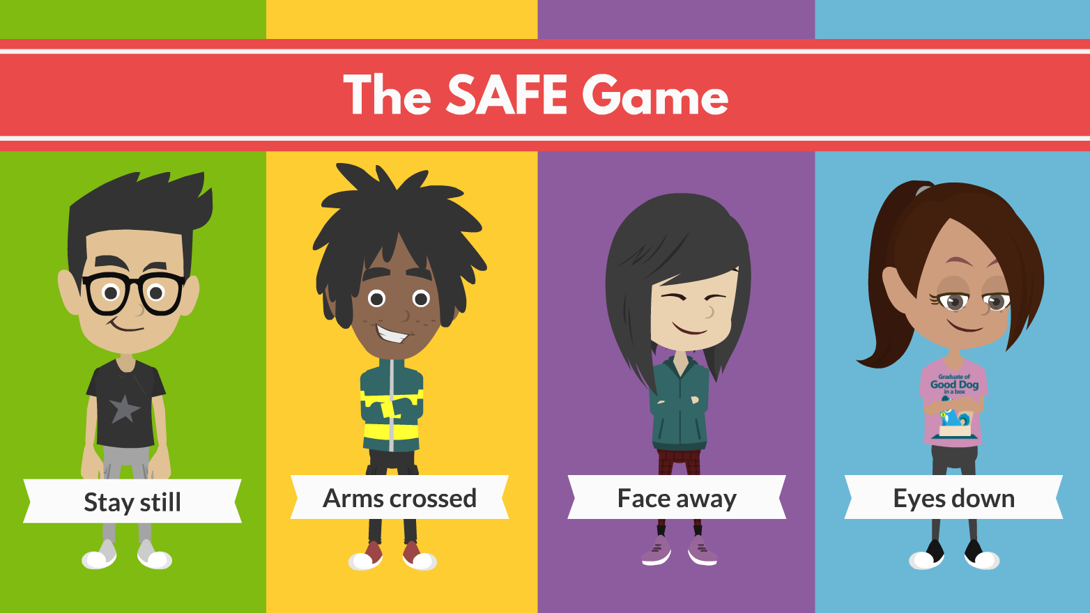
Notes:
So…4 things to remember!
Stay still…arms crossed…face away…eyes down.
Playing the SAFE game can make a dog lose interest and go away without hurting or biting you.

Slide 15
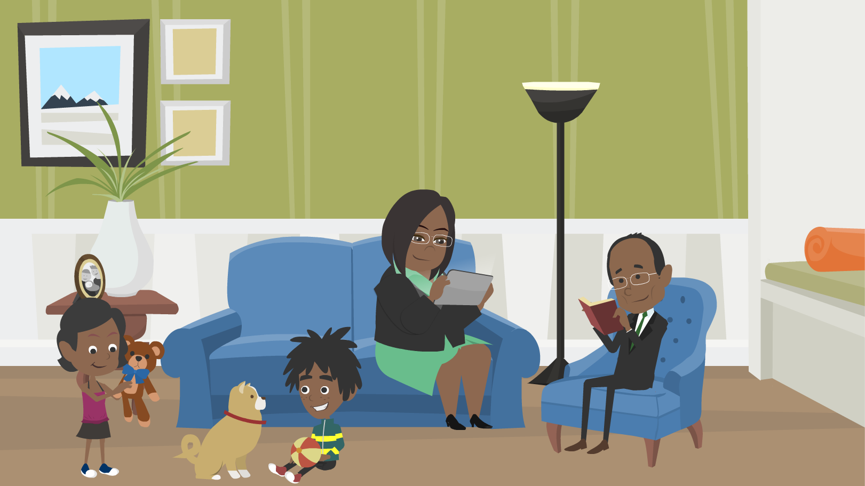
Dogs You Do Know
..Your own dog
..Your friend’s or neighbor’s dog
..Your grandparents’ dog
..Your aunt’s and uncle’s dog
Notes:
Lets talk about Dogs You Do Know
This dog could be..
..Your own dog
..Your friend’s or neighbor’s dog
..Your grandparents’ dog
..Your aunt’s and uncle’s dog

Slide 16
Notes:
There are 4 STEPS OF SAFE
Step 1. Soft touch but not too much. A lot of times when we go to pet a dog, we make a beeline for the dog’s head. Many dogs find having their head touched uncomfortable.

Slide 17
How to Pat a Dog
Don’t stare or put your face close to the dog’s face. This can make a dog very nervous
Put your closed hand out to greet the dog
Pat on his chest or side or shoulder, not on his head
Don’t reach over his head to pat him
Notes:
Please read text

Slide 18
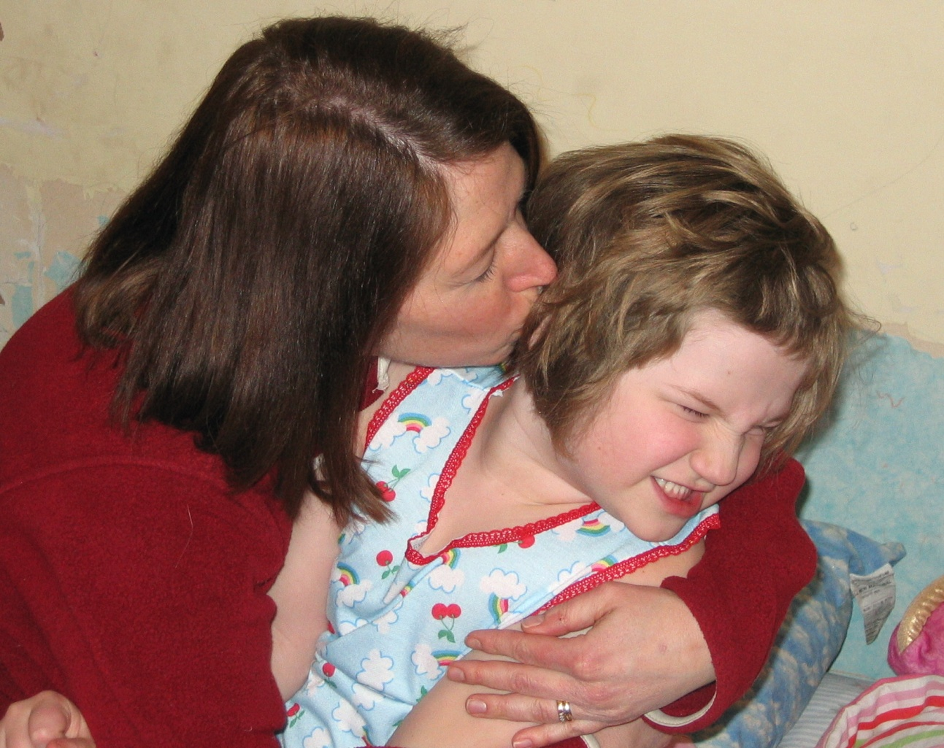
Don’t hug a dog! Dogs do not hug each other and may feel trapped or scared.
Notes:
Please read text

Slide 19
Notes:
Step 2. Ask the dog…we can’t ask her with words but we can watch what she does when we stop patting!

Slide 20
Let the dog decide….
If she wants more patting OR if she has had enough
If she walks away, that’s OK!
Respect the answer she gives you!
Notes:
Please read text

Slide 21
Notes:
3. Be a friend – there are times when the dog needs to be left alone

Slide 22
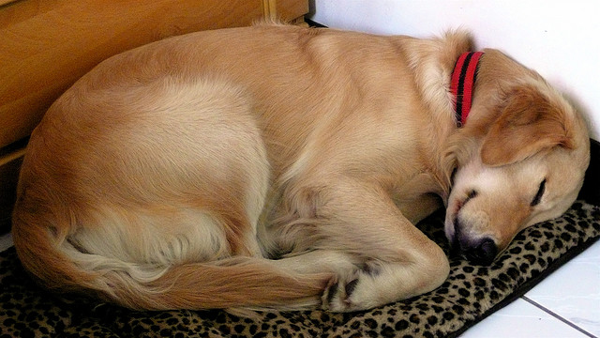
Be a friend… Leave the dog alone when he is sleeping or resting
Notes:
Please read text

Slide 23
His place to be resting could be …
In his crate
In his bed
On a sofa
By the fireplace
In a corner
In a different room away from the family
Like you, he deserves some quiet space where he can relax
Notes:
Please read text

Slide 24
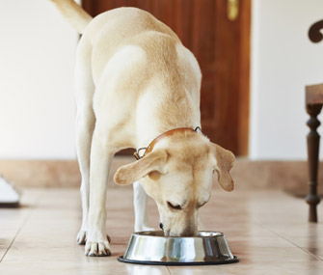
Be a friend… Leave your dog alone when she is eating! Dogs…like people.. do not want to be bothered while having their favorite food!
Notes:
Please read text

Slide 25
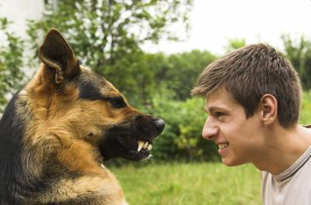
Be a friend…
Never EVER hit, yell at, or tease any dog.
Friends are not unkind
to friends!
Notes:
Please read text

Slide 26
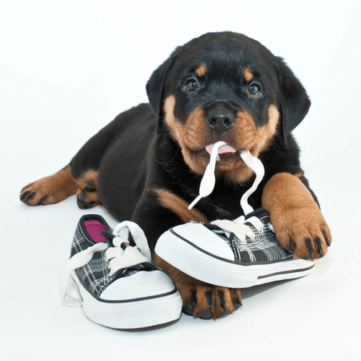
Be a Friend…
Leave a dog alone if he has a toy or he is chewing something—even if the “something” belongs to you!
Notes:
Please read text

Slide 27
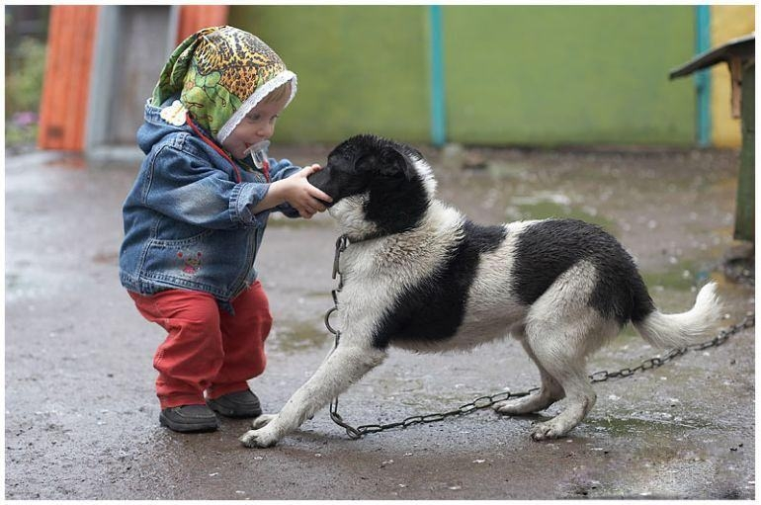
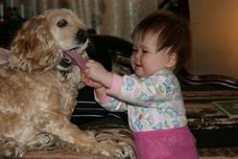
Be a Friend…
By not running up to any dog
Dogs do not like quick approaches, loud voices or rough play
Notes:
Please read text
These dogs do not look happy with what’s happening to them

Slide 28
Notes:
Step 4. Enjoy, but not as a toy - Don’t ride, push, or dress up your dog. Play with your dog by finding a game or activity that you BOTH enjoy, like going for a walk or playing with a ball.

Slide 29
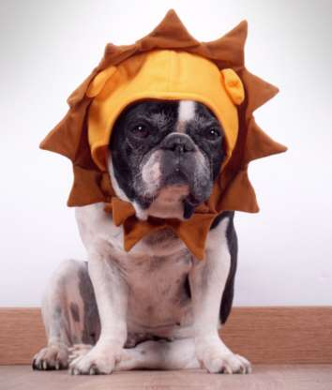
Enjoy but Not as a Toy…
Please don’t dress up your dog or anyone’s dog
Dogs are very uncomfortable with clothes or hats on
They already have wonderful furry and soft coats to wear!
Does this dog look happy?
Notes:
Please read text
We may think this is funny but this dog looks very, very unhappy.
He is probably thinking: “What did I do to deserve this?”

Slide 30
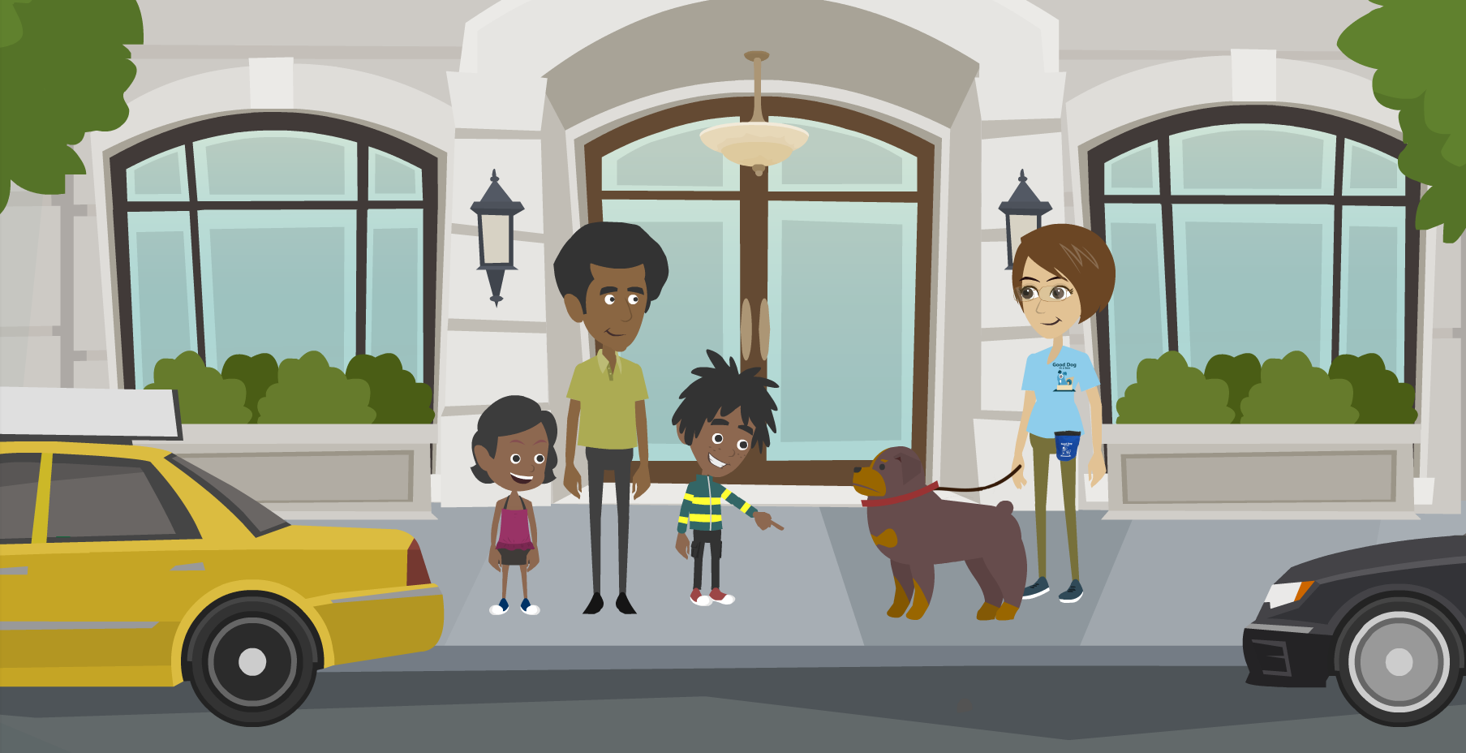
Meeting a New Dog
Notes:
Let’s learn the safe way to meet a new dog. Whenever you meet a new dog, you don’t know if he loves kids or if he’s afraid of kids. We always want to use safe behavior around a new dog and we want to stay calm and keep from getting really loud and excited.

Slide 31
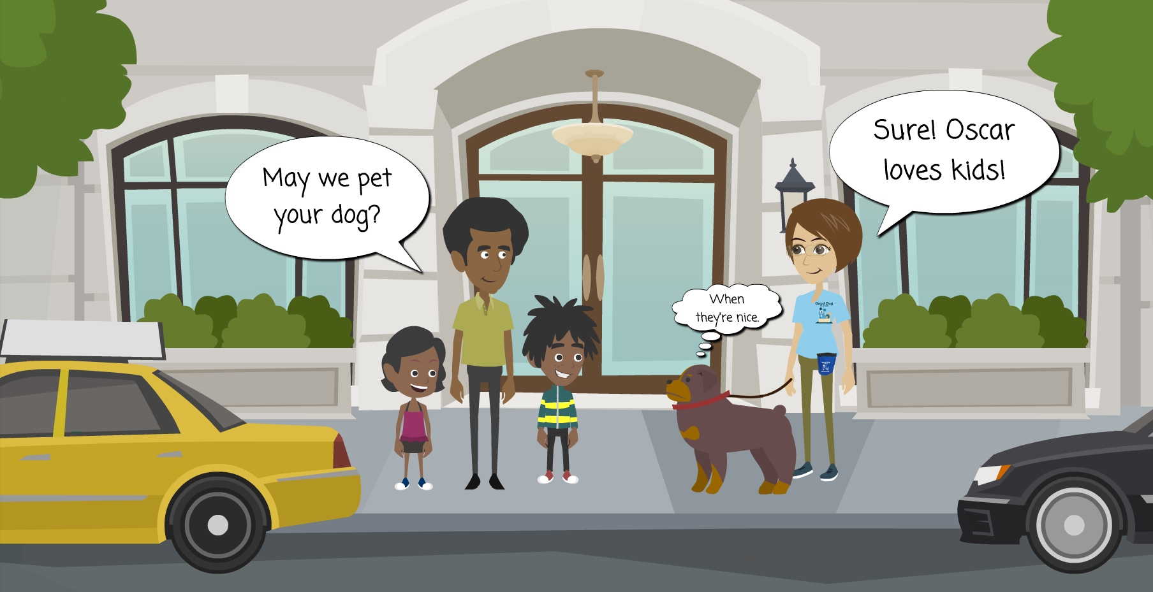
Always ask owner’s permission to approach the dog
Notes:
Always ask the owner’s permission to approach the dog. If the owner says no, respect that she knows her dog better than you do.

Slide 32
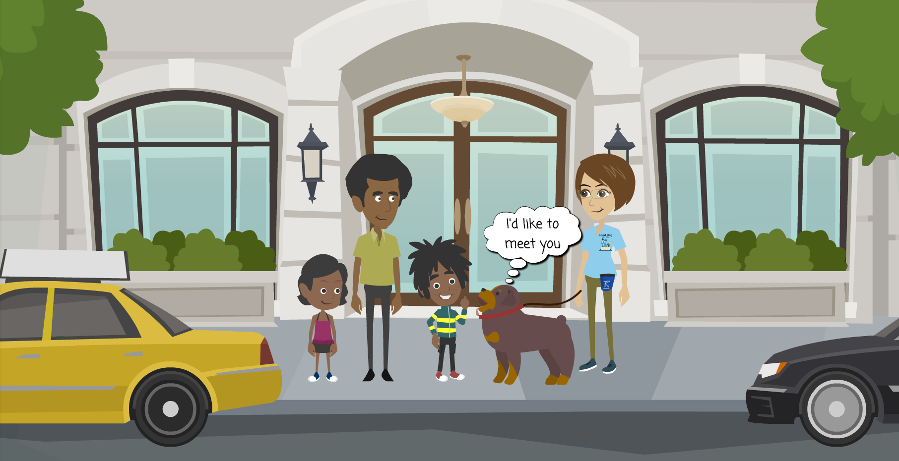
Make sure it looks like the dog wants to meet you too
Notes:
Make sure it looks like the dog wants to meet you too.
If the dog looks worried or is trying to move away, then don’t approach.

Slide 33
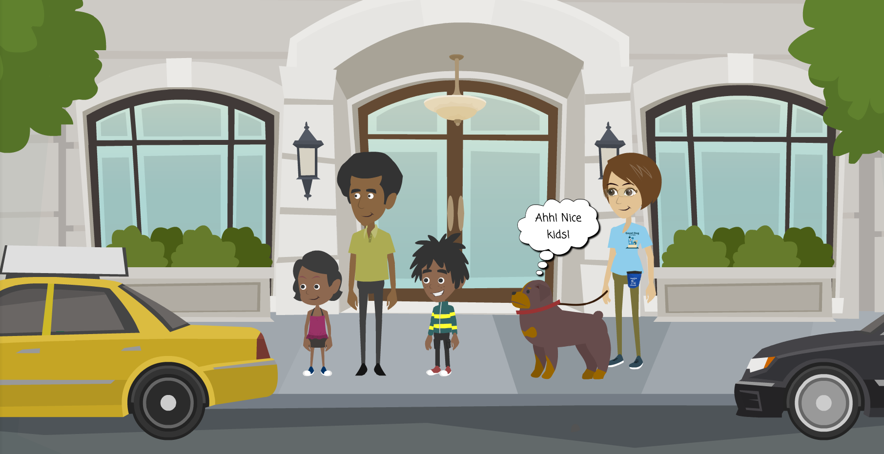
Stay still with your side or back towards the dog
Notes:
What you do want to do is stay still with your side or back towards the dog.
Let the dog approach on his own time.

Slide 34
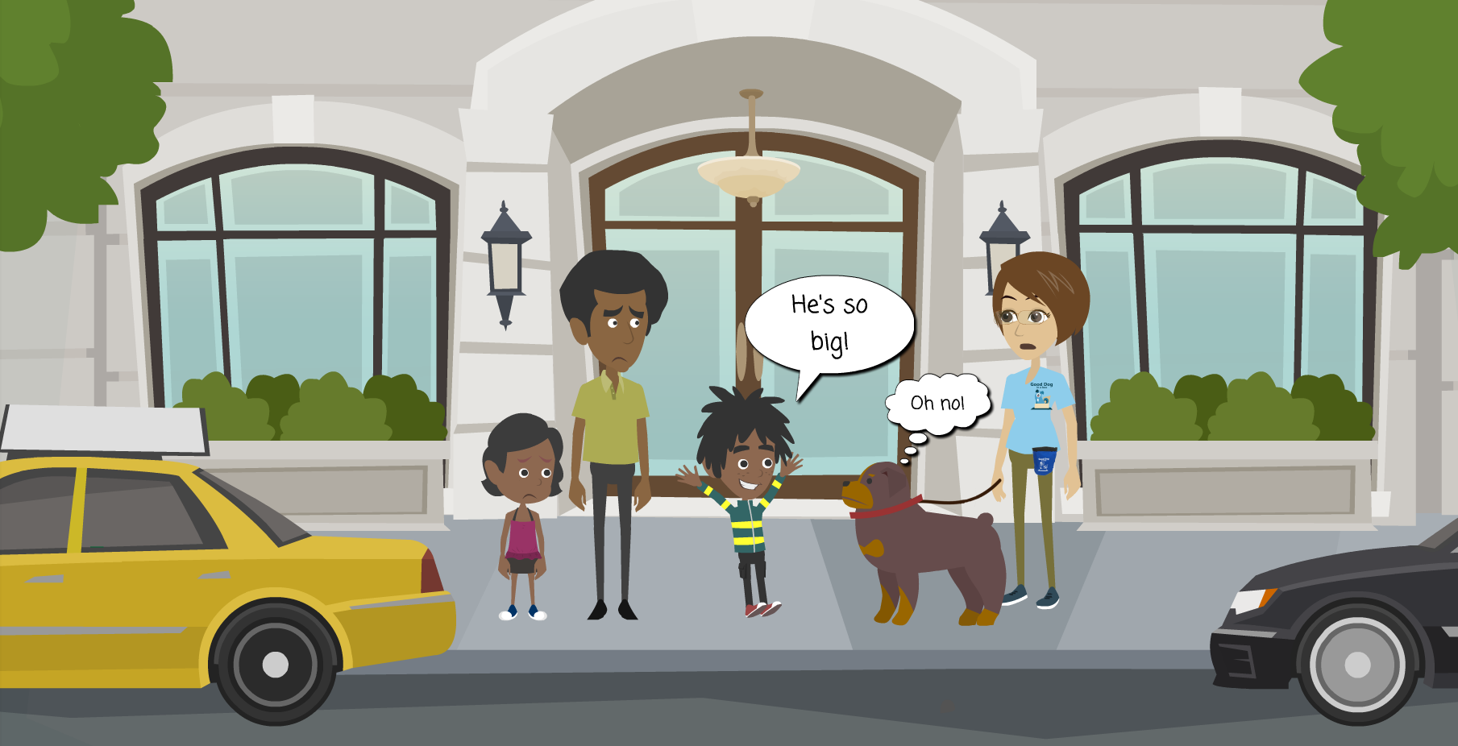
Don’t squeal or shout around the dog !
Notes:
Don’t squeal or shout around the dog.
Even if he is really, really cute!
Squealing or shouting is very scary to dogs.

Slide 35
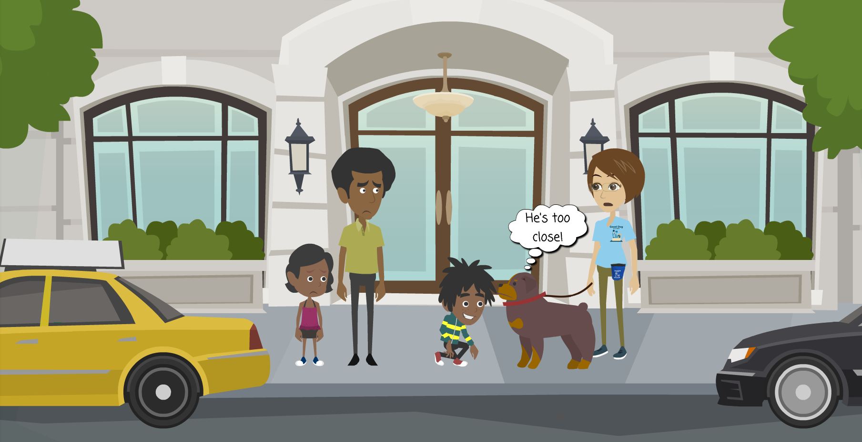
Don’t stick your face or hands in the dog’s face and don’t stare in the eyes of the dog!
Notes:
Please read text

Slide 36
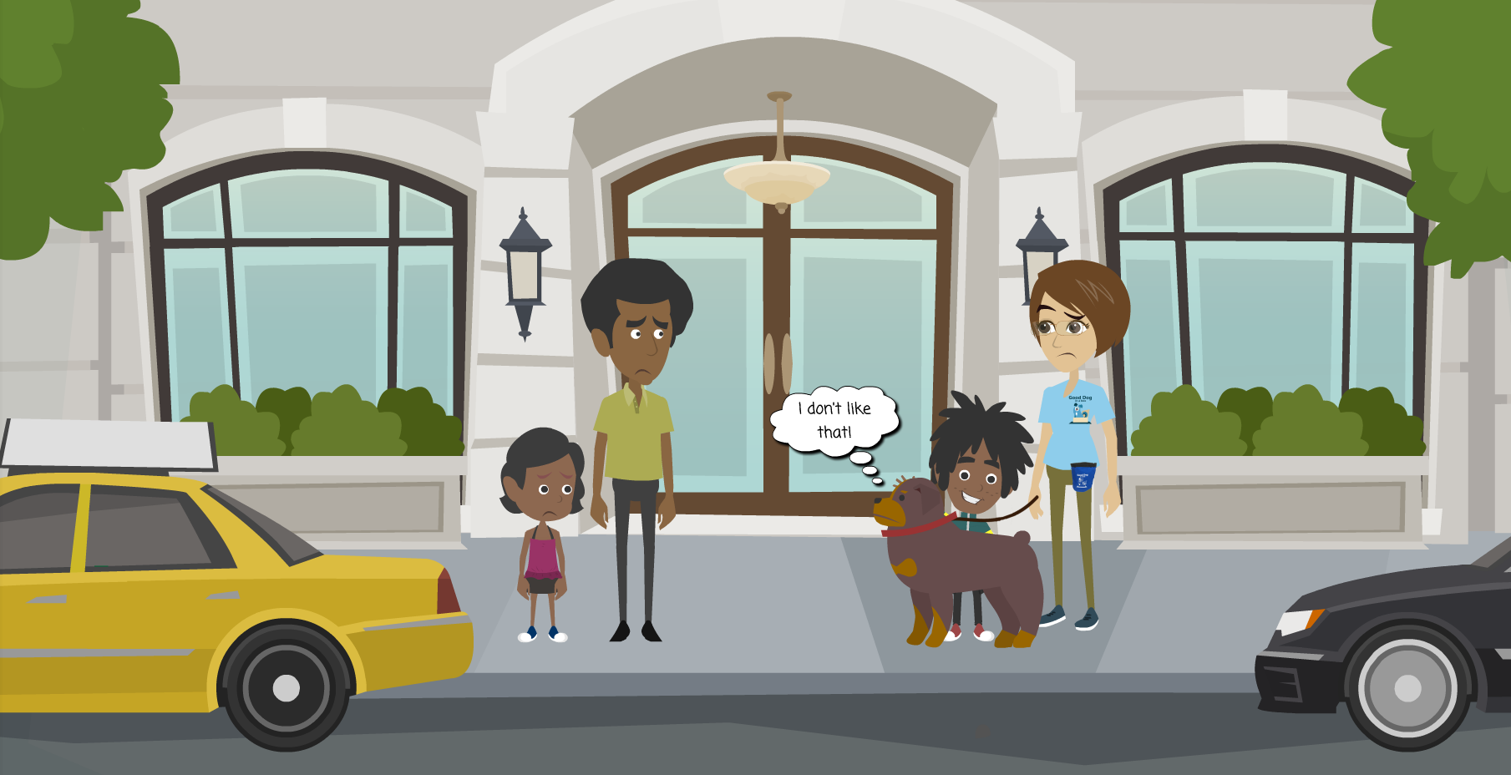
Don’t pet the dog on the top of the head
Notes:
Remember: don’t pet the dog on the top of the head.

Slide 37
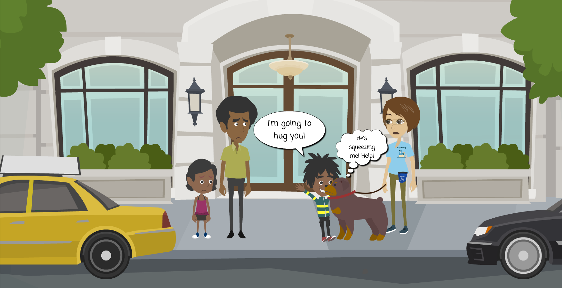
Don’t grab the dog and hug or kiss it- dogs don’t like hugs and kisses!
Notes:
Don’t grab the dog and hug or kiss it. Remember that dogs don’t like hugs and kisses.
Do you like to be hugged or kissed by people you just met? No!

Slide 38
Gently pet or stroke the dog on his chest or side or shoulder. When the dog walks away, he’s had enough.
Notes:
Gently pet or stroke the dog on his chest or on his back, not the top of his head. When the dog walks away, he’s had enough. Respect that.

Slide 39
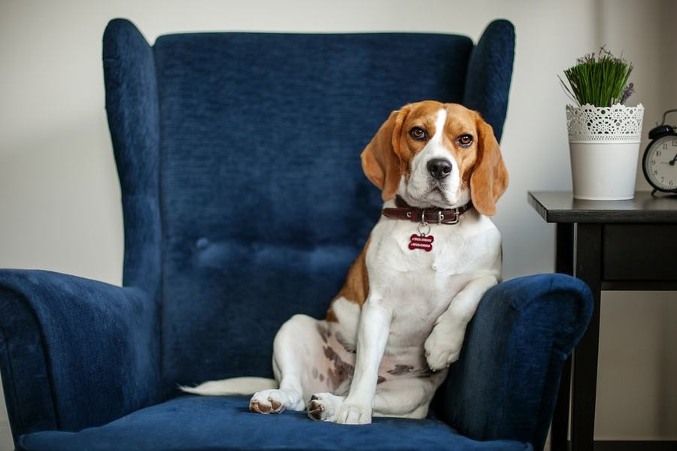
Lets learn how to “talk dog”
Notes:
Now let’s talk about dog body language. Most dogs give signs that they are happy or not happy but in order to “listen” to these signs we need to learn how to “talk dog.”

Slide 40
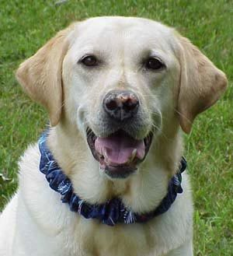
Happy Dog
Ears forward and relaxed
Relaxed posture
Mouth slightly open
Notes:
This is a Happy Dog. You can see his ears are floppy and hanging forward. And his mouth is slightly open. He looks relaxed.

Slide 41
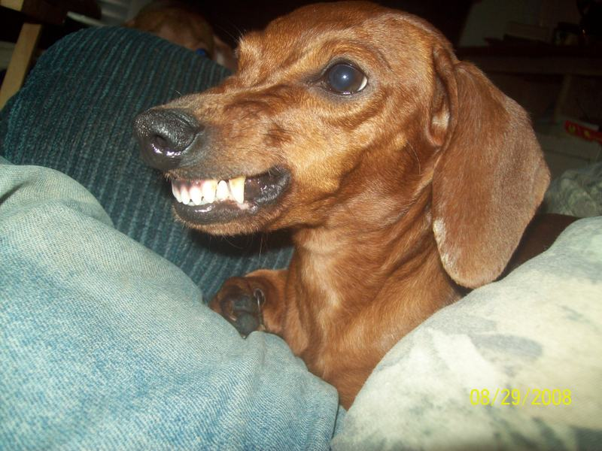
Threatening Dog
Showing teeth
Ears back
Growling
Hair standing up on back
Notes:
This is a Threatening Dog. You can see his teeth are showing, his muzzle is all wrinkled and tense, and his ears are pulled back and look stiff.
He is probably growling and if we could see the rest of his body we might notice that the hair on his back or neck is standing up.

Slide 42
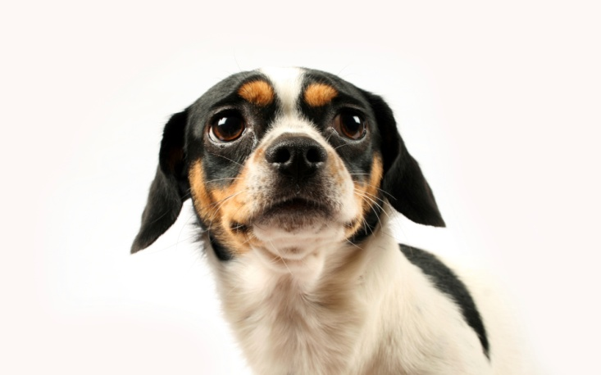
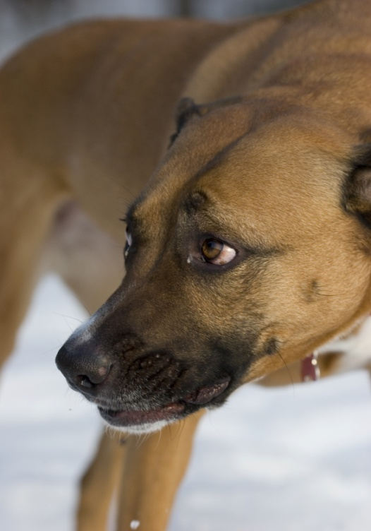
Scared Dog
Cowering
Fish eyes (whites of eyes showing)
Ears back
Worried facial expression
Notes:
This is a dog who is also not happy and he is showing us that he is Scared Dog. He is making himself look smaller, and you can see the whites of his eyes. His ears are pulled back, and he looks very worried about what is going on around him.

Slide 43
Never approach or pet a dog that is scared or threatening
Notes:
A really big lesson for us: never approach a dog that is scared or threatening.
Trying to get closer to a dog that is scared or threatening can result in a bite.
Leave the dog alone.

Slide 44
LET’S TAKE A QUIZ!!
Notes:
Please read text

Slide 45
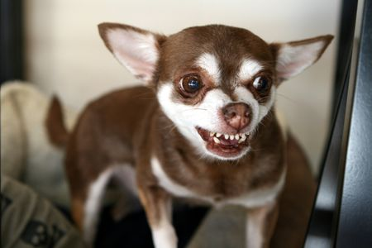
QUIZ
a) Happy b) Scared c) Threatening
Notes:
Is this dog Happy, Scared, or Threatening?
What do you see?
(Ears back, stiff, teeth bared, fish eye
Answer is C)

Slide 46
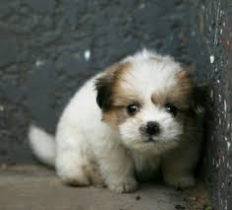
QUIZ
a) Happy b) Scared c) Threatening
Notes:
Is this dog Happy, Scared, or Threatening?
What do you see?
(Smaller, ears back, tense, staring
Answer is B)

Slide 47
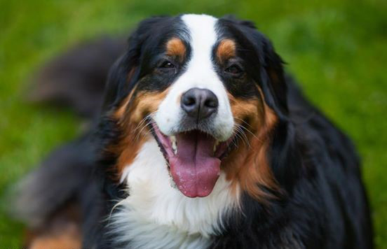
QUIZ
a) Happy b) Scared c) Threatening
Notes:
Is this dog Happy, Scared, or Threatening?
What do you see?
(Soft face, mouth slightly open, no wrinkles on face
Answer is A)

Slide 48
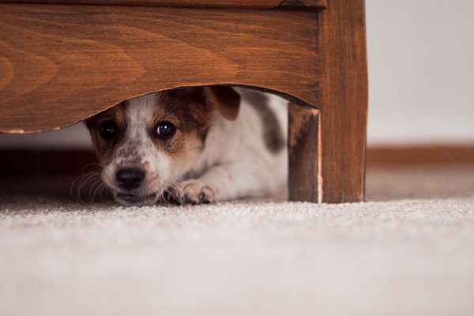
QUIZ
a) Happy b) Scared c) Threatening
Notes:
Is this dog Happy, Scared, or Threatening?
What do you see?
(Hiding, smaller, wrinkled face, fish eye and looks like he may be growling
Answer is B)

Slide 49
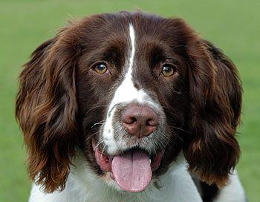
QUIZ
a) Happy b) Scared c) Threatening
Notes:
Is this dog Happy, Scared, or Threatening?
What do you see?
(Ears are floppy and hanging forward, soft eyes, mouth open, relaxed face
Answer is A)

Slide 50
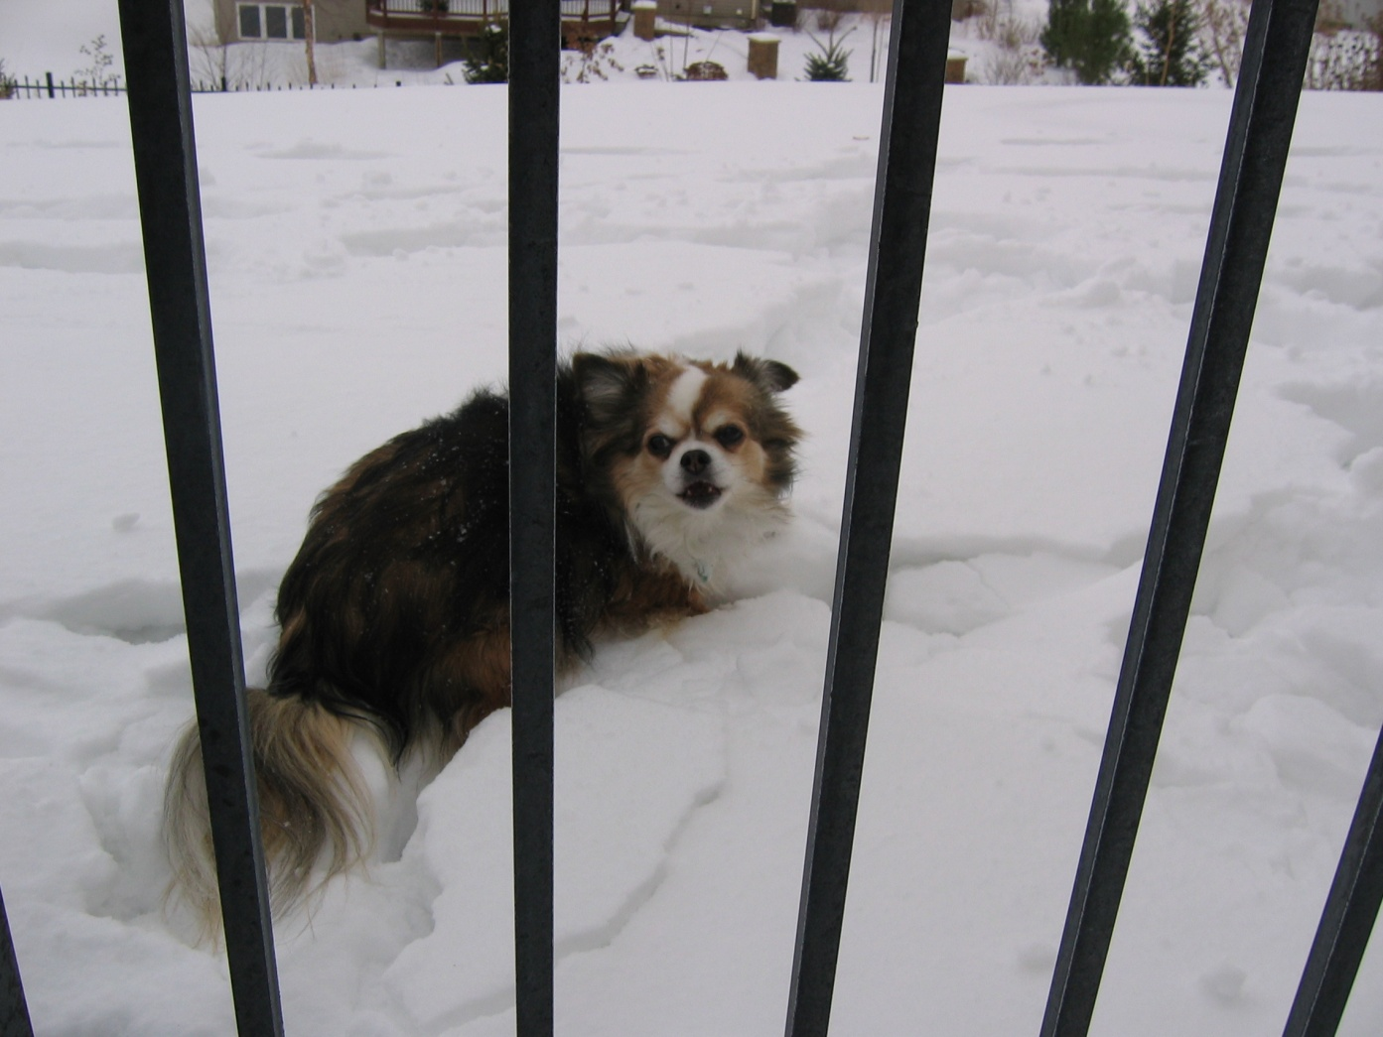
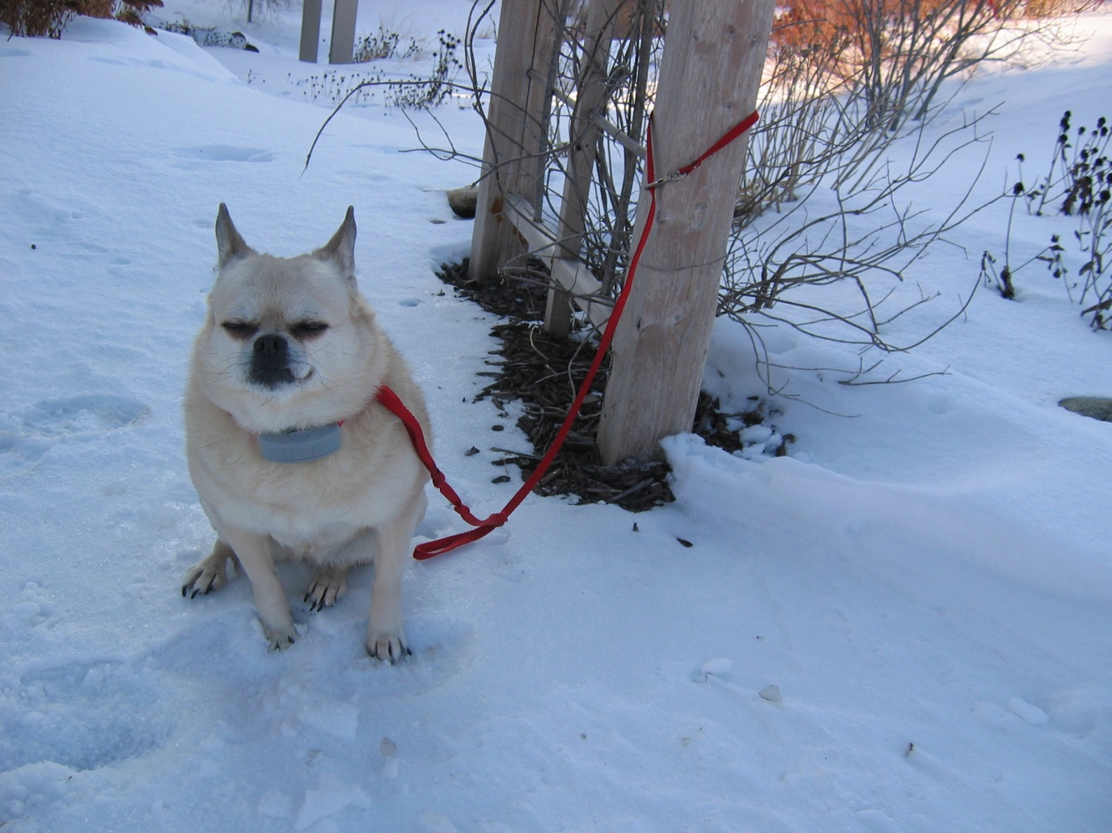
Quiz Is it okay to pet a dog through a fence or a dog that is tied up?
YES or NO?
Notes:
Is it okay to pet a dog through a fence or that is tied up?
Never ever!
He may feel you are in his space.
What should you do?
Walk on by and don’t stare at the dog!

Slide 51
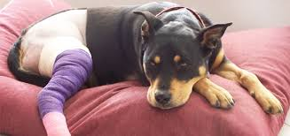
Quiz Is it okay to pet a dog who is injured?
YES or NO?
Notes:
Is it okay to pet a dog who is injured or not feeling well?
Never ever!
Dogs who are hurt or don’t feel well want to be left alone.

Slide 52
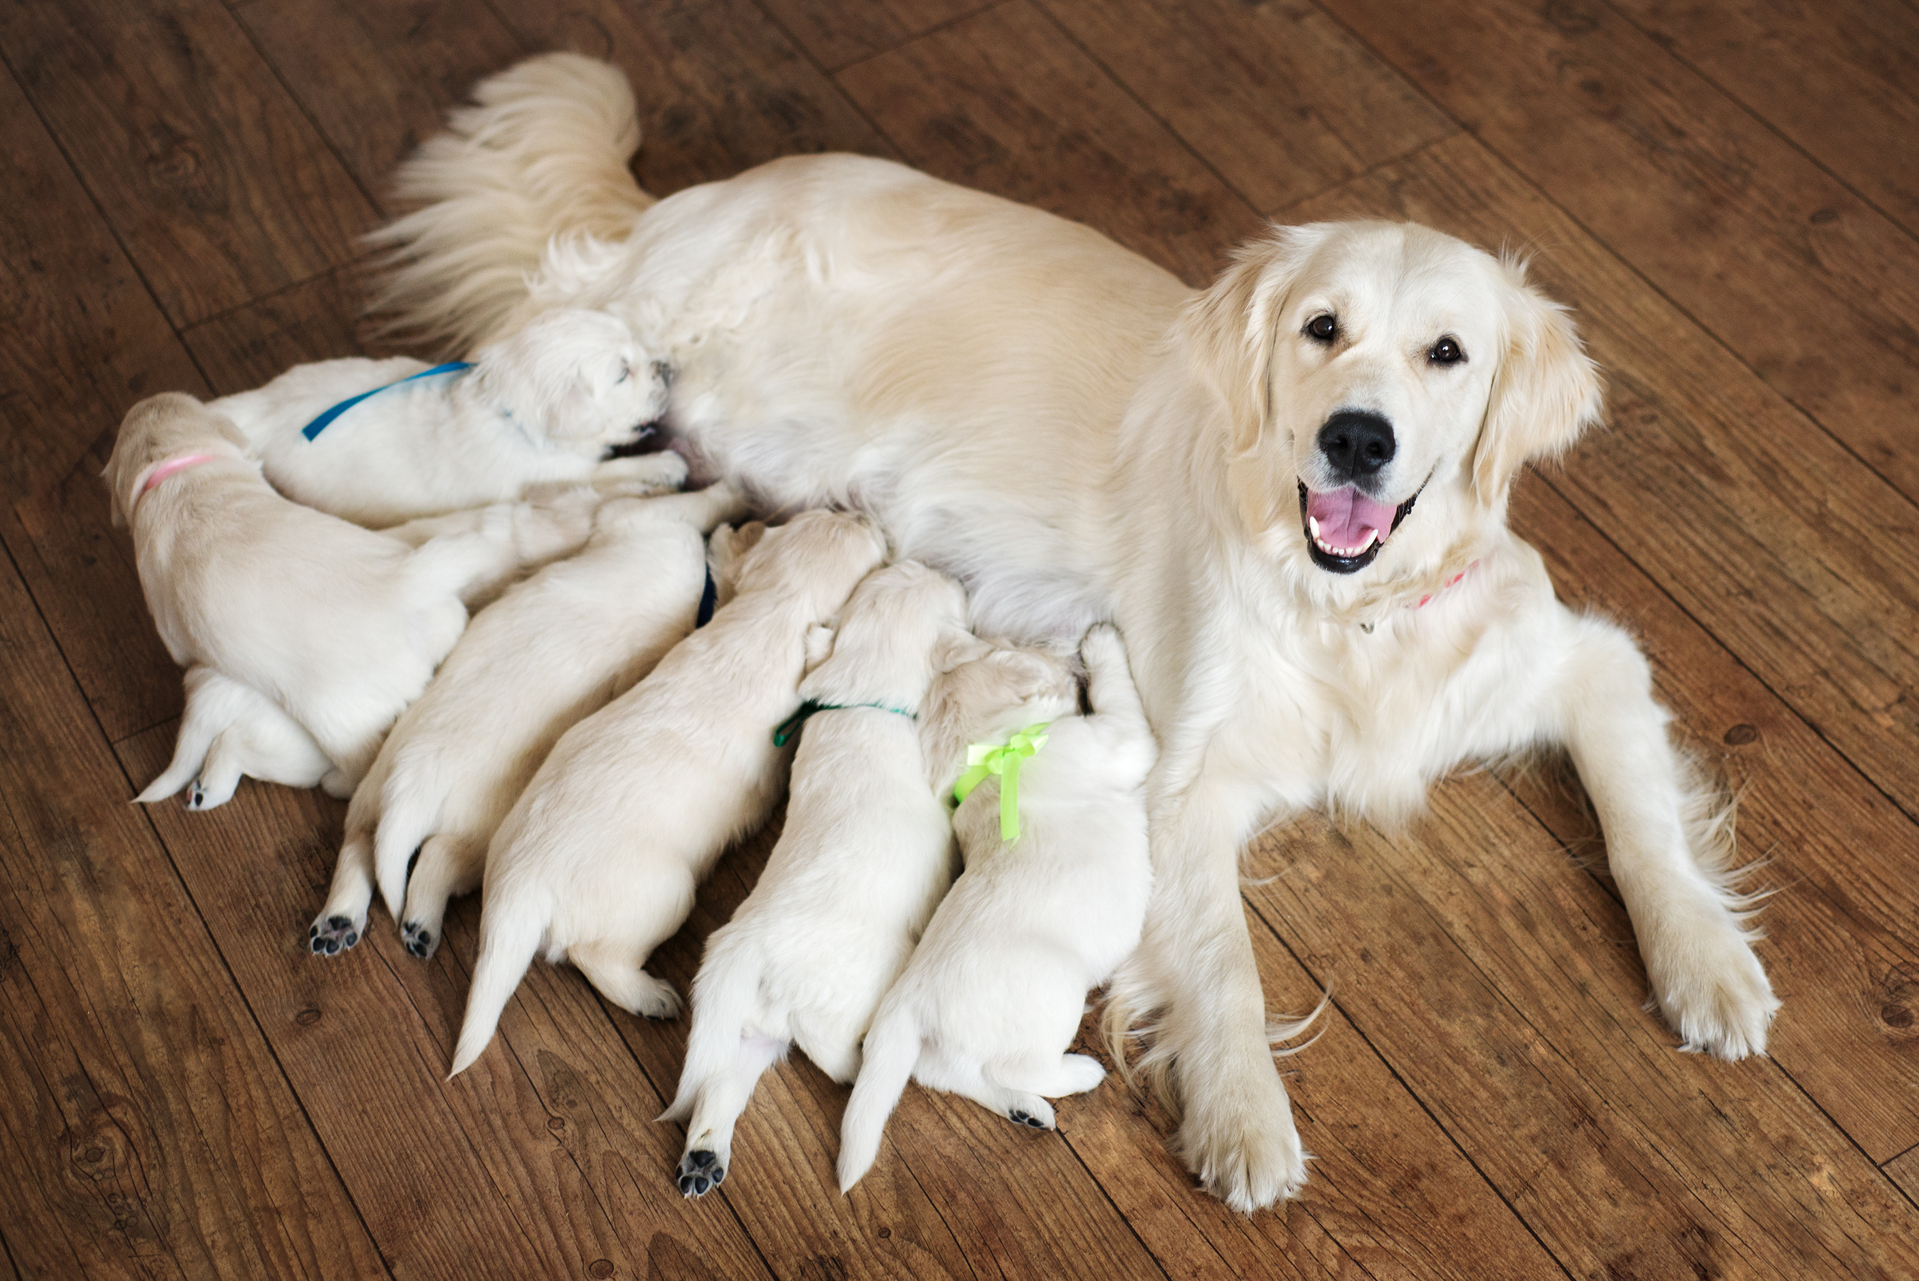
Quiz Is it okay to pat a mother dog when she is with her puppies?
YES or NO?
Notes:
Is it okay to pat a mother dog when she is with her puppies?
The answer is NO! Mother dogs can be very worried about anyone coming too close to her and her puppies.
Even though the puppies are really cute, leave Mom and the pups alone!

Slide 53
Quiz Is it okay to touch a dog through a car window?
YES or NO?
Notes:
Is it okay to touch a dog through an open car window?
The answer is NO! Never ever pat a dog through a car window.
The dog may feel you are invading his space. He may also be extra worried if his owner is not there so he may be very scared or threatening.
What should you do?
Walk on by!

Slide 54
Notes:
So…just to review The Safe Game if you meet a loose dog
Stay still…arms crossed…face away…eyes down.
Be very quiet and boring and the dog will lose interest.
.

Slide 55
Notes:
So..to review
Soft touch but not too much..pat gently and don’t hug!
Let the dog decide if he has had enough patting and wants to be left alone.
Be a Friend by never yelling, teasing, touching when eating or sleeping
Enjoy the dog..but please do not dress her up! Remember that dogs have feelings and are not toys!

Slide 56
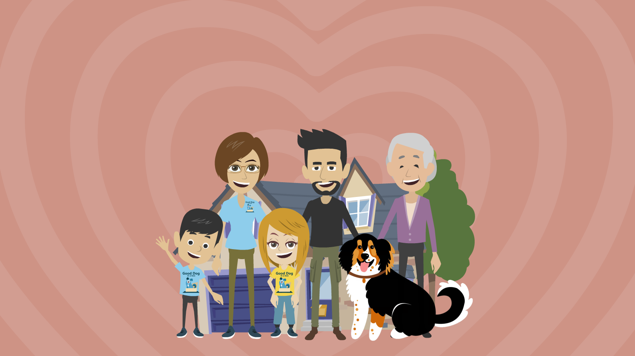
One last thing to remember…
Dogs can be wonderful friends, but we must learn how to be SAFE around them.
Let’s do our part to decrease the number of kids bitten by dogs every year!
Notes:
Please read text.
Thank you so much for paying attention today. Who has questions?

Slide 57
Thank you to the following for providing some of the content for our program!!
Notes:
Thank you to the Minnesota Veterinary Medical Association and Good Dog in a Box.com for providing some of the content for our program.

